Slide 1

SQL PROJECT
STUDENT MANAGEMENT SYSTEM
www.reallygreatsite.com

Slide 2
SUMMARY
This project covers:
Table design and relationships
Basic queries
JOINs
Aggregates (COUNT, AVG)
Subqueries and NULL handling
Data modification (UPDATE, DELETE)

Slide 3
MODULES & TABLES INVOLVED:
1. Students Table
Stores student info: name, age, gender, etc.
2. Courses Table
Stores course info: course name, credits.
3. Enrollments Table
Links students with courses and records grades.
4. Departments Table (Optional)
Stores academic department information.

Slide 4
Q1. LIST ALL STUDENTS.
SELECT * FROM Students;
CREATE TABLE Students (
StudentID INT PRIMARY KEY,
Name VARCHAR(100),
Gender VARCHAR(10),
Age INT
)

Slide 5
Q2. FIND THE NAMES OF STUDENTS WHO HAVE ENROLLED IN THE 'MATH' COURSE.
SELECT s.Name
FROM Students s
JOIN Enrollments e ON s.StudentID = e.StudentID
JOIN Courses c ON e.CourseID = c.CourseID
WHERE c.CourseName = 'Math';

Slide 6
Q3. COUNT THE NUMBER OF COURSES EACH STUDENT IS ENROLLED IN.
SELECT s.Name, COUNT(e.CourseID) AS CourseCount
FROM Students s
JOIN Enrollments e ON s.StudentID = e.StudentID
GROUP BY s.Na
me;

Slide 7
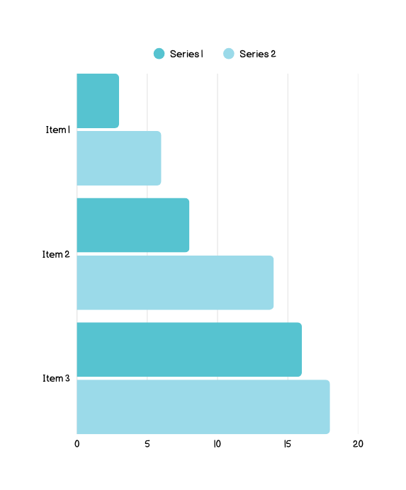
Q4. FIND STUDENTS WHO GOT GRADE 'A'.
SELECT s.Name, c.CourseName
FROM Students s
JOIN Enrollments e ON s.StudentID = e.StudentID
JOIN Courses c ON e.CourseID = c.CourseID
WHERE e.Grade = 'A';

Slide 8
Q5. LIST COURSES AND NUMBER OF STUDENTS ENROLLED IN EACH.
SELECT c.CourseName, COUNT(e.StudentID) AS StudentCount
FROM Courses c
LEFT JOIN Enrollments e ON c.CourseID = e.CourseID
GROUP BY c.CourseNa
me;

Slide 9
Q6. FIND THE AVERAGE AGE OF STUDENTS.
SELECT AVG(Age) AS AverageAge FROM Students;

Slide 10

Q7. SHOW STUDENTS NOT ENROLLED IN ANY COURSE.
SELECT s.Name
FROM Students s
LEFT JOIN Enrollments e ON s.StudentID = e.StudentID
WHERE e.EnrollmentID IS NU
LL;

Slide 11
Q8. LIST ALL GRADES OBTAINED BY 'ALICE'.
SELECT c.CourseName, e.Grade
FROM Enrollments e
JOIN Courses c ON e.CourseID = c.CourseID
JOIN Students s ON e.StudentID = s.StudentID
WHERE s.Name = 'Alice';

Slide 12
Q9. CHANGE THE GRADE OF STUDENT WITH ENROLLMENTID = 2 TO 'A'.
UPDATE Enrollments SET Grade = 'A' WHERE EnrollmentID = 2;

Slide 13
Q10. DELETE A STUDENT WHO HAS ID = 3.
DELETE FROM Students WHERE StudentID = 3;

Slide 14
Studio Shodwe
THANK YOU
BY RUFUS STEWART
www.reallygreatsite.com

